Slide 1


Incorporating heterogeneity in farmer disease control behaviour into a livestock disease transmission model
Ed Hill, Naomi Prosser, Paul Brown, Eamonn Ferguson, Martin Green,
Jasmeet Kaler, Martin Green, Matt Keeling, Mike Tildesley
Zeeman Institute: Systems Biology & Infectious Disease
Epidemiology Research (SBIDER), University of Warwick

Slide 2
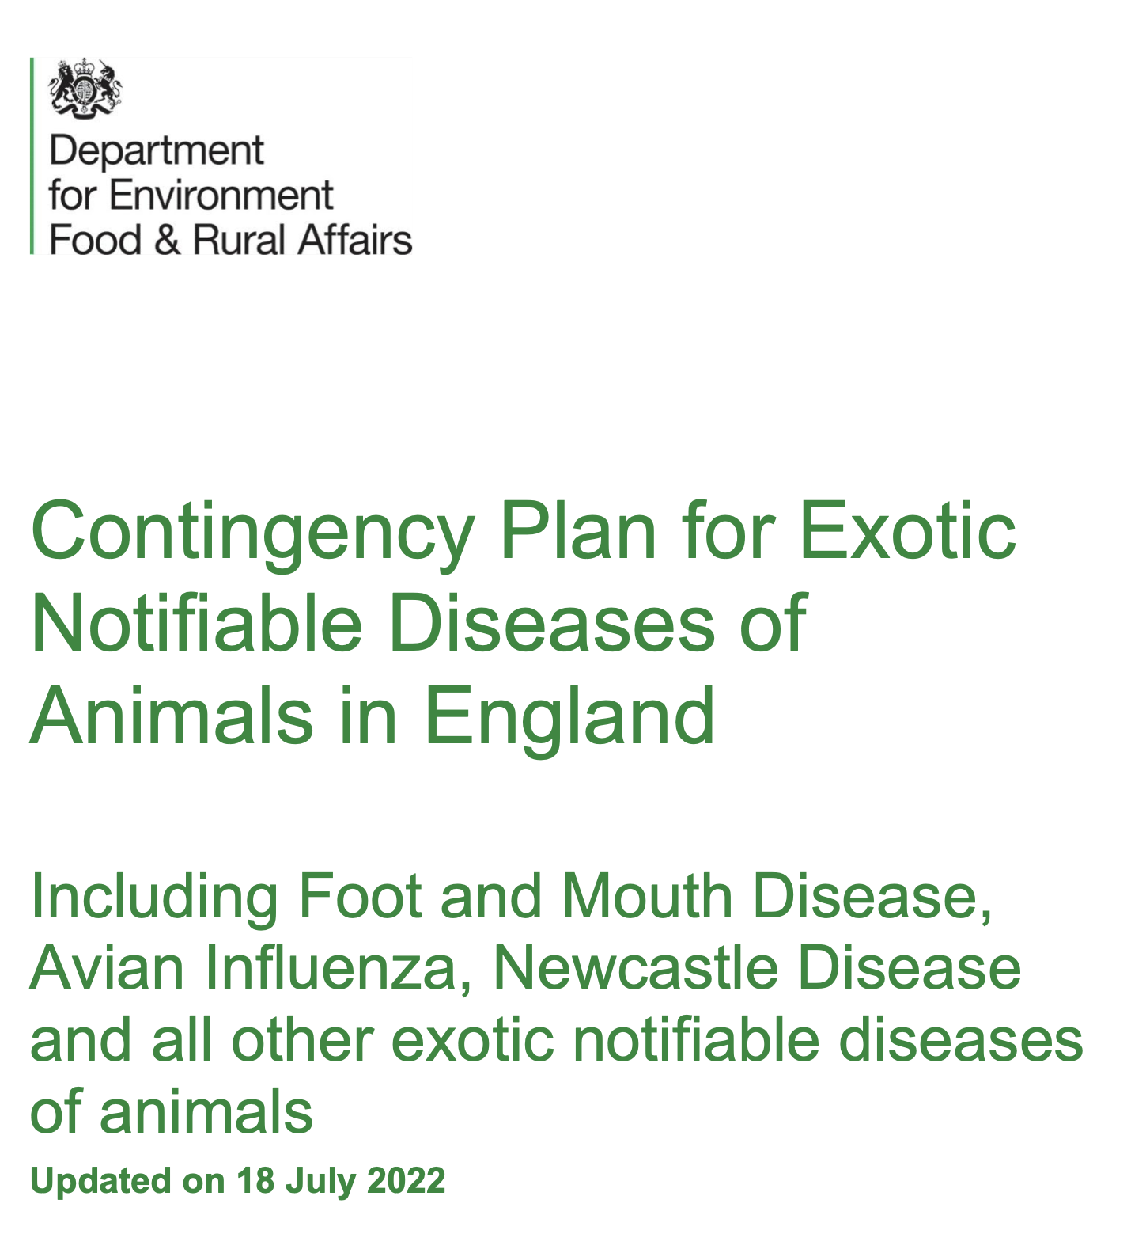
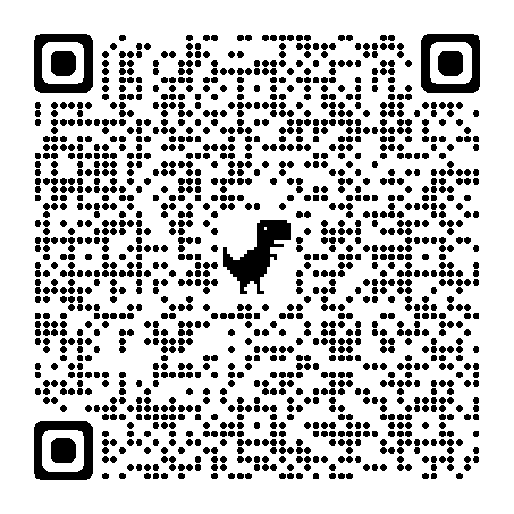
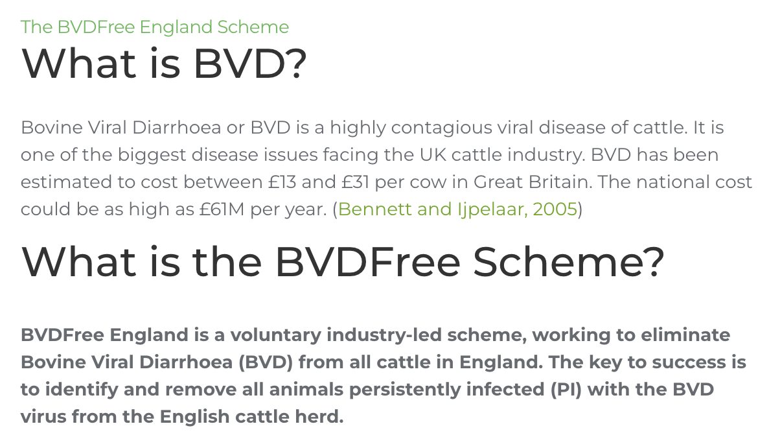
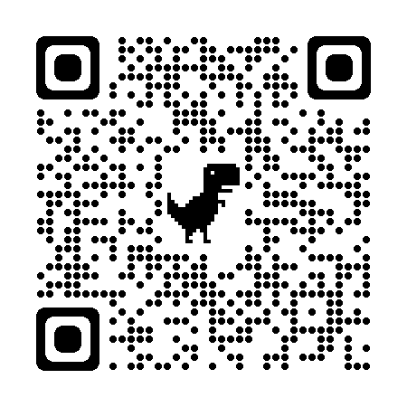

Approaches to control infectious disease outbreaks in livestock
Direct action of farmers
Government action
Ed Hill @EdMHill KSMB-SMB 2024 2
Notes:
There are essentially two main ways in which infectious diseases of livestock can
be controlled: either by the direct action of farmers who take the initiative for disease control and
prevention on their farm;
Examples in the UK include the voluntary removal of cattle persistently infected with BVDV.
Or by national bodies imposing control measures. Examples include the imposed movement
restrictions and at-risk culling that occurred during the 2001 FMD outbreak.
Document describes how the government will manage an outbreak or incident of exotic notifiable disease (those not normally present in the country) of animals including poultry in England

Slide 3
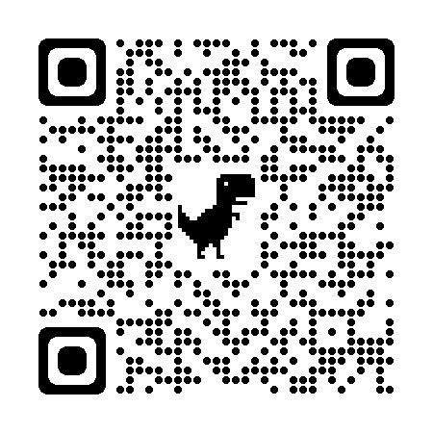

Farmer-led Epidemic and Endemic Disease-management (FEED)
FEED project webpage: https://feed.warwick.ac.uk
Project motivation
A knowledge gap on the different factors that drive farmer behaviour in response to an emerging disease.
Mathematical modelling approaches traditionally treat farmers as passive bystanders & omit variation in disease management behaviours
Ed Hill @EdMHill KSMB-SMB 2024 3
Notes:
This work was conducted as part of the BBSRC-funded Farmer-led Epidemic and Endemic Disease-management project, hereafter referred to as the FEED project. The FEED project is an interdisciplinary research group including mathematical modellers, behavioural scientists and veterinarians from the University of Warwick and University of Nottingham.
It is recognised that farmer behaviour is critical to reduce the spread of an infection, thereby enhancing animal welfare and reducing economic losses. Therefore, one of the overall goals of the FEED project is to further our understanding of the different factors that drive farmer behaviour in response to a disease outbreak.
Furthermore, though disease transmission models are a useful aid for giving insights on the potential impacts of control strategies, they usually focus on the effect of nationally imposed control and treat farmers as having similar behaviours towards disease management.

Slide 4






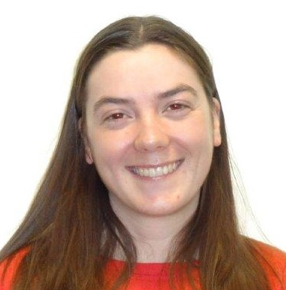

The Team
Infectious disease modelling
Scientific software
Paul Brown
(University of Warwick)
Mike Tildesley
Matt Keeling
(University of Warwick)
Behavioural psychology
Veterinary epidemiology
Eamonn Ferguson
(University of Nottingham)
Naomi Prosser
Martin Green
Jasmeet Kaler
(University of Nottingham)
Ed Hill @EdMHill KSMB-SMB 2024 4

Slide 5
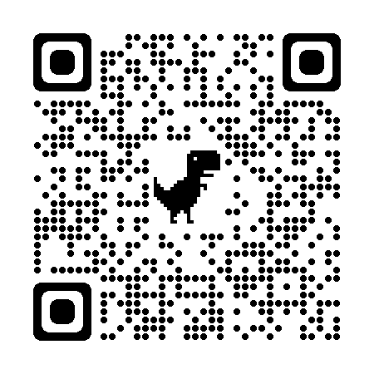
Study aims
Elicit farmers vaccination decisions to an unfolding epidemic and link to their psychosocial and behavioural profiles (within Great Britain)
Refine mathematical disease models to capture psychosocial & behaviour change heterogeneities
Assess how psychosocial & behaviour change factors impact epidemiological outcomes given a fast-spreading livestock disease
Incorporating heterogeneity in farmer disease control behaviour into a livestock disease transmission model EM Hill, NS Prosser, PE Brown, E Ferguson, MJ Green, J Kaler, MJ Keeling, MJ Tildesley. (2023) ​
Preventive Veterinary Medicine.
doi:10.1016/j.prevetmed.2023.106019
Ed Hill @EdMHill KSMB-SMB 2024 5

Slide 6
Study aims
Elicit farmers vaccination decisions to an unfolding epidemic and link to their psychosocial and behavioural profiles (within Great Britain)
Ed Hill @EdMHill KSMB-SMB 2024 6

Slide 7
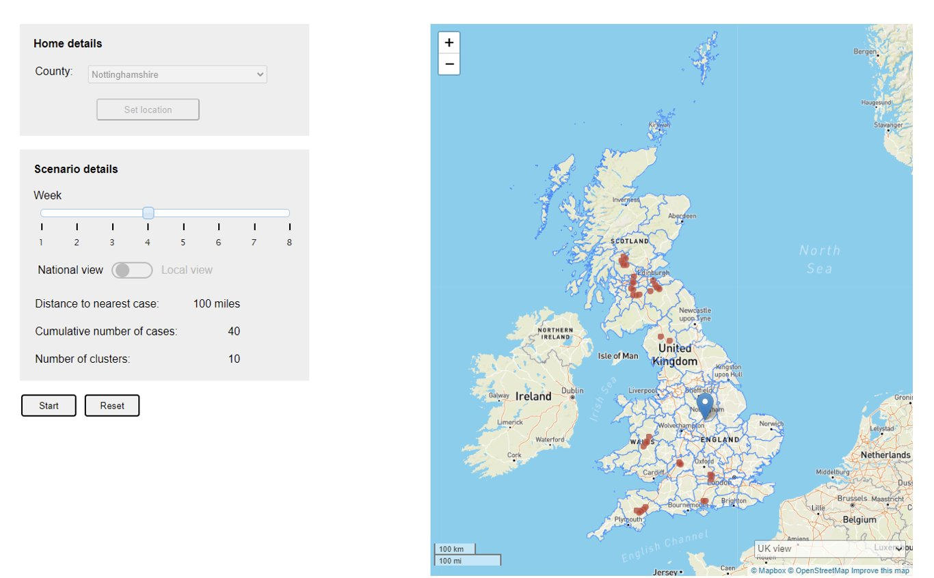
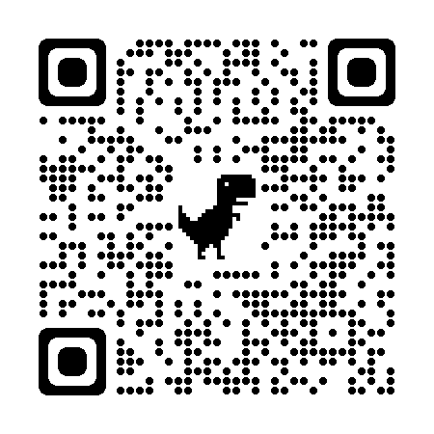
Elicitation methods - GUI
https://feed.warwick.ac.uk/map.html
Gave a common outbreak experience in terms of distance to the nearest infected herd for all farmers.
Ed Hill @EdMHill KSMB-SMB 2024 7

Slide 8
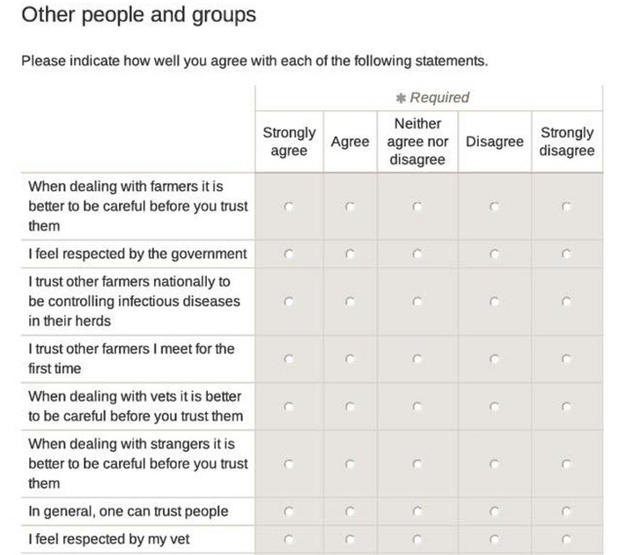
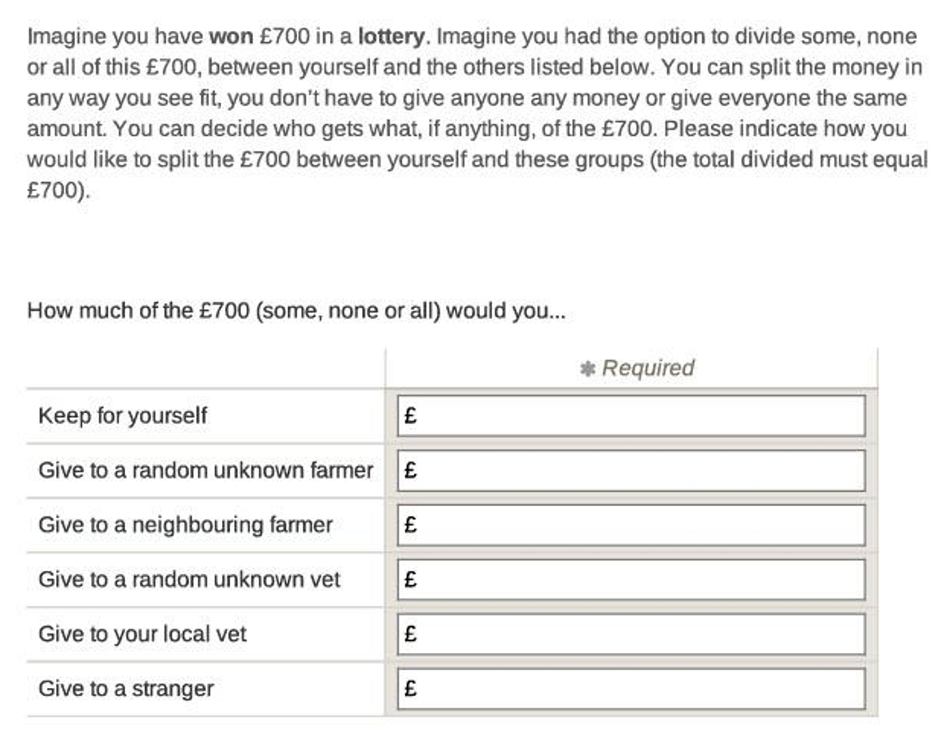
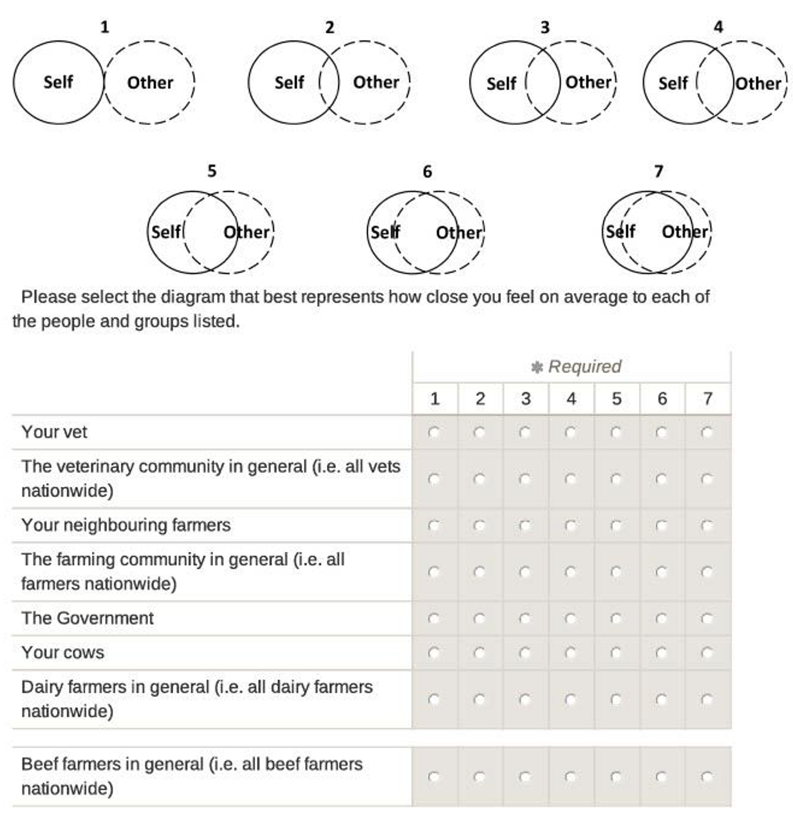
Elicitation methods - Questionnaire
Ed Hill @EdMHill KSMB-SMB 2024 8

Slide 9
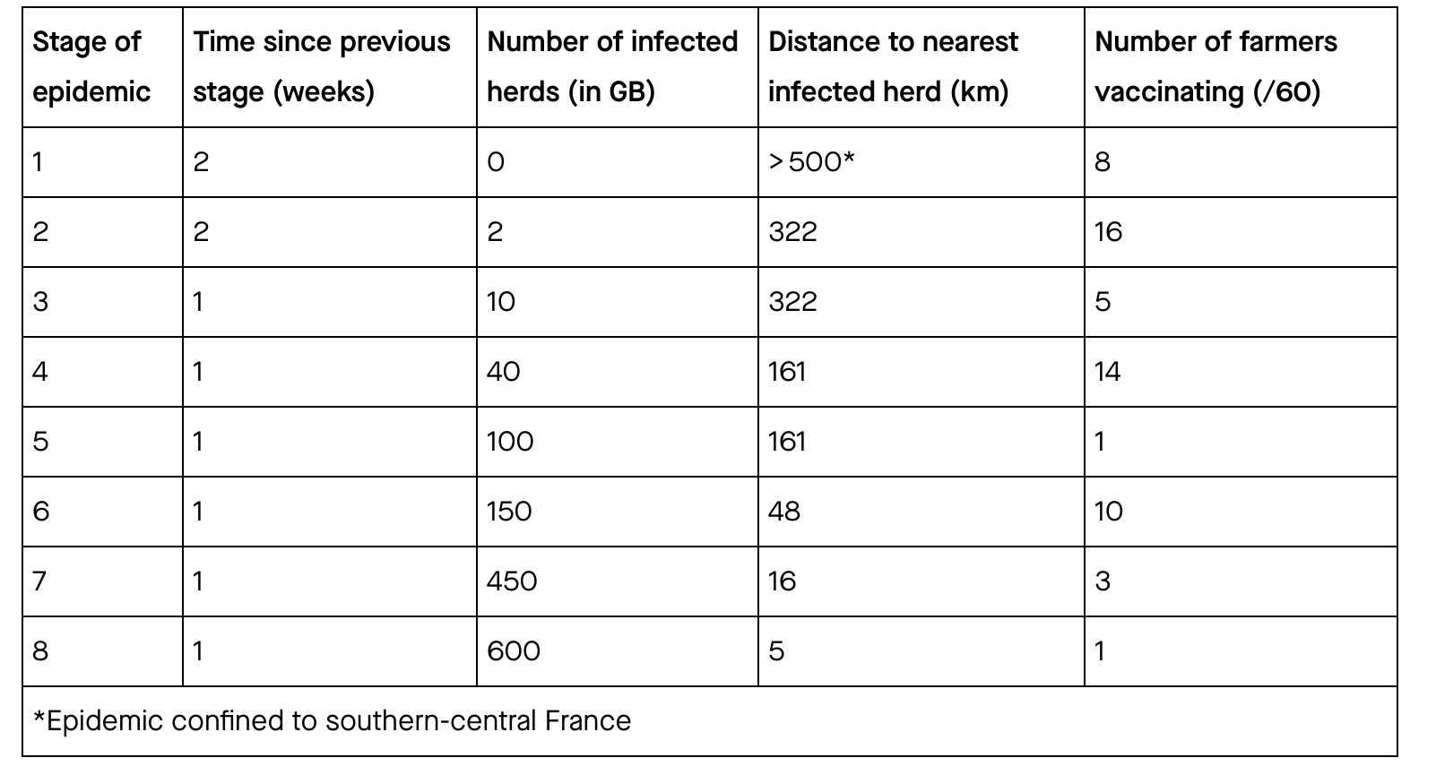
Elicitation results – GUI simulation
Table: Number of infected herds, distance of the nearest infected herd from the interviewee’s herd and number of farmers that vaccinated each week during the disease epidemic scenario.
Sixty farmers (39 beef & 21 dairy) participated, with variability apparent in when they would use preventative vaccination.
Ed Hill @EdMHill KSMB-SMB 2024 9

Slide 10
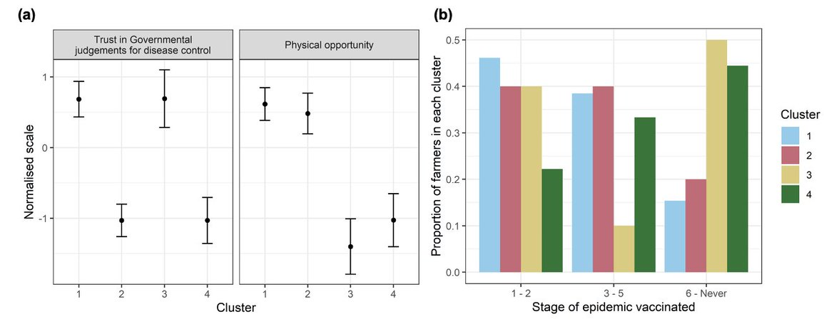
Elicitation results – Farmer groupings
Using k-means clustering, four groups gave best fit when clustering by two most stable covariates (trust in Governmental judgements for disease control, high physical opportunity)
Figure: Farmer groups from k-means clustering conducted on the two most stable covariates.
(a) Mean and 95% confidence interval scores of the covariates for each group. (b) Proportion of farmers in each group that vaccinated in different stages of the outbreak.
Ed Hill @EdMHill KSMB-SMB 2024 10

Slide 11
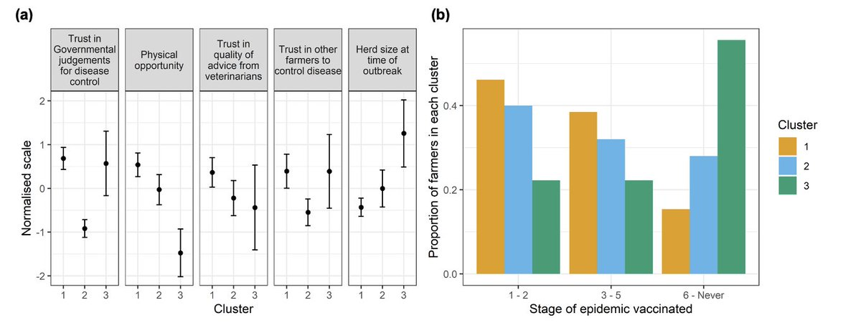
Elicitation results – Farmer groupings
Grouping using five most stable covariates, three groups gave best fit.
Additional covariates: Trust in vet advice, trust in other famers to control disease, herd size.
Figure: Farmer groups from k-means clustering conducted on the five most stable covariates.
(a) Mean and 95% confidence interval scores of the covariates for each group. (b) Proportion of farmers in each group that vaccinated in different stages of the outbreak.
Ed Hill @EdMHill KSMB-SMB 2024 11

Slide 12
Study aims
Elicit farmers vaccination decisions to an unfolding epidemic and link to their psychosocial and behavioural profiles (within Great Britain)
Refine mathematical disease models to capture psychosocial & behaviour change heterogeneities
Data-driven model framework with epidemiological and behavioural layers.
Assess how psychosocial & behaviour change factors impact epidemiological outcomes given a fast-spreading livestock disease
Ed Hill @EdMHill KSMB-SMB 2024 12

Slide 13
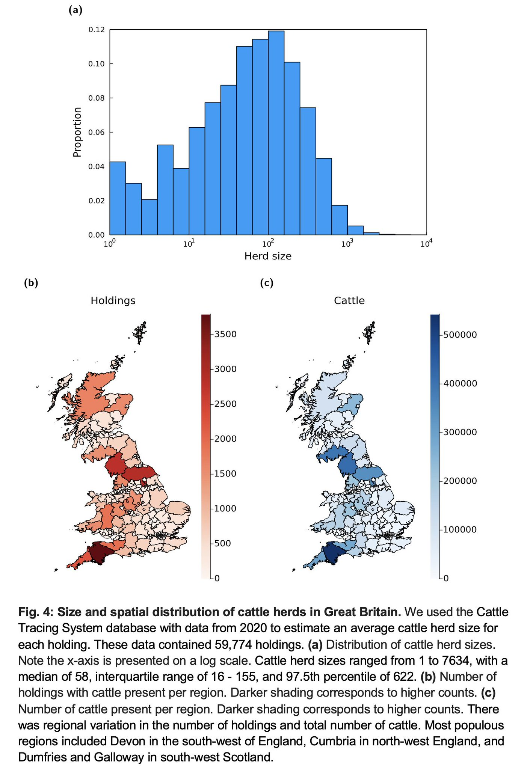
Modelling methods - Cattle data
Average 2020 cattle herd sizes from the Cattle Tracing System.
Figure: (a) Distribution of cattle herd sizes. (b) Number of holdings with cattle per region. (c) Number of cattle per region.
Ed Hill @EdMHill KSMB-SMB 2024 13

Slide 14
Modelling methods – Disease states
Epidemiological unit: Premises.
Spatial model, based loosely on the dynamics of FMD.
Force of infection dependencies: Number of livestock, livestock type specific transmissibility and susceptibility, distance between premises.
Infection to infectiousness (latent period): 5 days
Infection to notification: 9 days
Infection to culled: 13 days
S
E
I
N
C
Susceptible
Latent/
exposed
Infectious &
unnotified
Infectious & notified
Culled
Ed Hill @EdMHill KSMB-SMB 2024 14

Slide 15
Modelling methods – Disease states
Epidemiological unit: Premises.
Spatial model, based loosely on the dynamics of FMD.
Force of infection dependencies: Number of livestock, transmissibility, distance between premises.
Infection to infectiousness (latent period): 5 days
Infection to notification: 9 days
Infection to culled: 13 days
S
E
I
N
C
Susceptible
Latent/
exposed
Infectious &
unnotified
Infectious & notified
Culled
Ed Hill @EdMHill KSMB-SMB 2024 15

Slide 16
Modelling methods – Force of infection
Infected premises contribution: Dependent on herd size
Susceptible premises contribution: Dependent on herd size
Transmission kernel: Force of infection between premises dependent on the distance between them.
Ed Hill @EdMHill KSMB-SMB 2024 16

Slide 17
Modelling methods – Force of infection
Infected premises contribution: Dependent on herd size
Susceptible premises contribution: Dependent on herd size
Transmission kernel: Force of infection between premises dependent on the distance between them.
Ed Hill @EdMHill KSMB-SMB 2024 17

Slide 18
Modelling methods – Force of infection
Infected premises contribution: Dependent on herd size
Susceptible premises contribution: Dependent on herd size
Transmission kernel: Force of infection between premises dependent on the distance between them.
Ed Hill @EdMHill KSMB-SMB 2024 18

Slide 19
Modelling methods – Force of infection
Infected premises contribution: Dependent on herd size
Susceptible premises contribution: Dependent on herd size
Transmission kernel: Force of infection between premises dependent on the distance between them.
Ed Hill @EdMHill KSMB-SMB 2024 19

Slide 20
Modelling methods – Disease states
Epidemiological unit: Premises.
Spatial model, based loosely on the dynamics of FMD.
Force of infection dependencies: Number of livestock, livestock type specific transmissibility and susceptibility, distance between premises.
Infection to infectiousness (latent period): 5 days
Infection to notification: 9 days
Infection to culled: 13 days
S
E
I
N
C
Susceptible
Latent/
exposed
Infectious &
unnotified
Infectious & notified
Culled
Ed Hill @EdMHill KSMB-SMB 2024 20

Slide 21
Modelling methods – Disease states
Epidemiological unit: Premises.
Spatial model, based loosely on the dynamics of FMD.
Force of infection dependencies: Number of livestock, livestock type specific transmissibility and susceptibility, distance between premises.
Infection to infectiousness (latent period): 5 days
Infection to notification: 9 days
Infection to culled: 13 days
S
E
I
N
C
Susceptible
Latent/
exposed
Infectious &
unnotified
Infectious & notified
Culled
Ed Hill @EdMHill KSMB-SMB 2024 21

Slide 22
Modelling methods – Disease states
Epidemiological unit: Premises.
Spatial model, based loosely on the dynamics of FMD.
Force of infection dependencies: Number of livestock, livestock type specific transmissibility and susceptibility, distance between premises.
Infection to infectiousness (latent period): 5 days
Infection to notification: 9 days
Infection to culled: 13 days
S
E
I
N
C
Susceptible
Latent/
exposed
Infectious &
unnotified
Infectious & notified
Culled
Ed Hill @EdMHill KSMB-SMB 2024 22

Slide 23
Modelling methods –
Behavioural configurations
Uncooperative
Uncooperative Only control is cattle being removed at holdings with confirmed infection. i.e. No holdings apply vaccination.
Homogeneous: Non-data informed
Farmer vaccinates when infection is within:
Strong parasitism – 50km
Weak parasitism – 320km
Mutual cooperation – Before pathogen emergence
Heterogeneous: Non-data informed
Even split across different groups.
Coop-Parasitism-Free riders (FR)
Coop-Parasitism
Heterogeneous: Data informed
Parameterised using interview results
Trust expectancy (two covariate model)
Herd size dependent (five covariate model)
Ed Hill @EdMHill KSMB-SMB 2024 23
Notes:
Data informed configurations: used the interview results to parameterise: (i) the split of holdings between behavioural groups; (ii) in each behavioural group the partitioning of the holdings between the different intervention timings .

Slide 24
Study aims
Elicit farmers vaccination decisions to an unfolding epidemic and link to their psychosocial and behavioural profiles (within Great Britain)
Refine mathematical disease models to capture psychosocial & behaviour change heterogeneities
Assess how psychosocial & behaviour change factors impact epidemiological outcomes given a fast-spreading livestock disease
Spatial stochastic simulations of a fast-spreading epidemic process in Great Britain amongst cattle holdings:
Per behavioural configuration, ran 500 replicates for each of the 89 seed region locations.
Per simulation replicate, seeded infection in a randomly selected cluster of three premises.
Ed Hill @EdMHill KSMB-SMB 2024 24

Slide 25
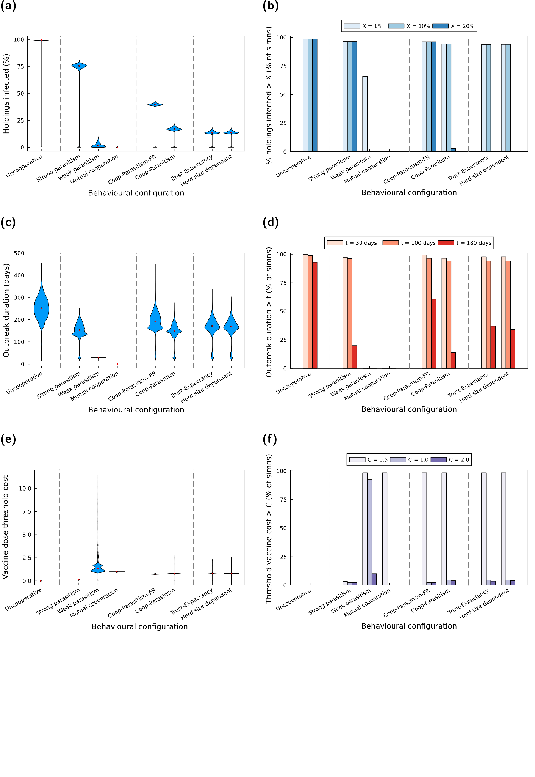
Modelling results –
Epidemiological metrics
Figure: For each behavioural configuration: (a) Distribution of percentage of holdings infected; (b) Percentage of simulations exceeding the stated final size; (c&d) Analogous summary statistics for outbreak duration.
Homogeneity in farmer behaviour vs data-informed psychosocial profile clusters estimates: Disconnect in outcomes
Ed Hill @EdMHill KSMB-SMB 2024 25

Slide 26
Modelling results –
Health economic metrics
Vaccine dose threshold cost: The maximum amount you can spend on a single vaccine dose where the total monetary cost (across vaccines and losses due to infection) does not exceed the monetary cost of infection incurred in the no intervention scenario (uncooperative configuration).
Figure: For each behavioural configuration: (e) Distribution of vaccine dose threshold costs; (f) Percentage of simulations exceeding the stated vaccine dose threshold cost.
Ed Hill @EdMHill KSMB-SMB 2024 26
Notes:
For our strong parasitism realisations there were examples where outbreaks resulted in few onward infections beyond the initial three infected holdings (seeded with infection at the beginning of the simulation). In such instances, one would be willing to spend a higher amount per intervention unit whilst keeping the strategy cost-effective compared with the baseline strategy (reflected by 2.2% of simulations returning a threshold unit intervention cost above 2).
Meanwhile, the threshold unit intervention cost exhibited more variability for weak parasitism than in most other scenarios, spanning 0 to 11.5. It was very likely to be in the range of 0.5 to 1, with a small chance of it being larger than 2 (achieved in 10.1% of simulations).
Similar outcomes for the non-data informed heterogenous behavioural configurations & data informed heterogenous behavioural configuration.

Slide 27
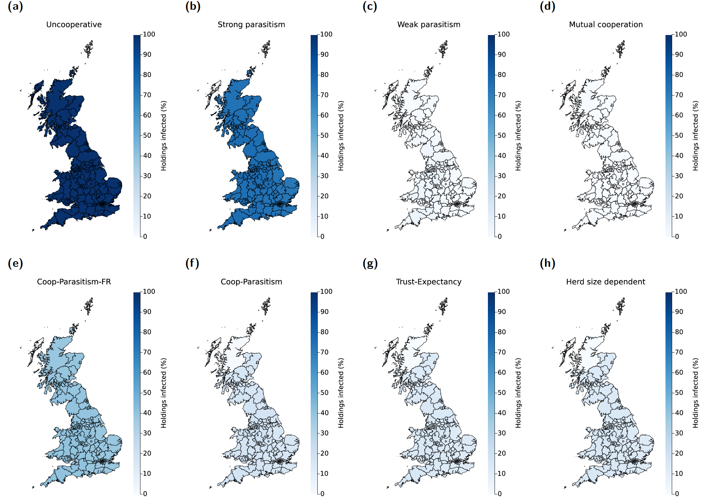
Modelling results –
Role of seed infection region
Figure: Median percentage of holdings infected, dependent on region of outbreak emergence and behavioural configuration. Statistics computed from 500 replicates per scenario.
Ed Hill @EdMHill KSMB-SMB 2024 27
Notes:
Intensity of shading corresponds to the percentage of holdings infected during the entire outbreak when the initial infecteds were located within that region; darker shading corresponds to higher values.

Slide 28
Limitations & further work
Elicitation
Behavioural cluster analysis not feasible at regional level
Are other intervention practices available to farmers
Modelling
Focused on a limited set of interventions
Considered a single set of epidemiological parameters
Open questions– what are the next steps?
Support to establish longitudinal elicitation studies
Tailored elicitation exercises to instruct behavioural group attributes amongst farmers towards control of enzootic diseases
Ed Hill @EdMHill KSMB-SMB 2024 28
Notes:
Are other intervention practices available to farmers that can lower infection risk against their herd that may have different associations with psychosocial factors
As with any model, not capable of perfectly replicating the biological real-world system & multiple simplifying assumptions made

Slide 29
Implications
A demonstration of a conjoined epidemiological and
socio-behavioural workflow in action!
Encourage consideration of actions of individual farmers in policy frameworks for tackling future livestock disease outbreaks
Ed Hill @EdMHill KSMB-SMB 2024 29

Slide 30

Acknowledgements
Mike Tildesley, Matt Keeling, Paul Brown
Zeeman Institute: Systems Biology & Infectious Disease Epidemiology Research (SBIDER),
University of Warwick, UK.
Naomi Prosser, Jasmeet Kaler, Martin Green,
School of Veterinary Medicine and Science, University of Nottingham, UK.
Eamonn Ferguson
School of Psychology, University of Nottingham, UK.
Animal and Plant Health Agency (APHA)
Incorporating heterogeneity in farmer disease control behaviour into a livestock disease transmission model EM Hill, NS Prosser, PE Brown, E Ferguson, MJ Green, J Kaler, MJ Keeling, MJ Tildesley. (2023) ​
Preventive Veterinary Medicine.
doi:10.1016/j.prevetmed.2023.106019
FEED project webpage: https://feed.warwick.ac.uk
Email: Edward.Hill@warwick.ac.uk
Personal webpage: https://edmhill.github.io
Ed Hill @EdMHill KSMB-SMB 2024 30

Slide 31

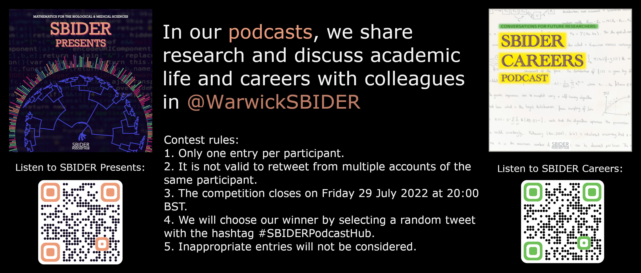
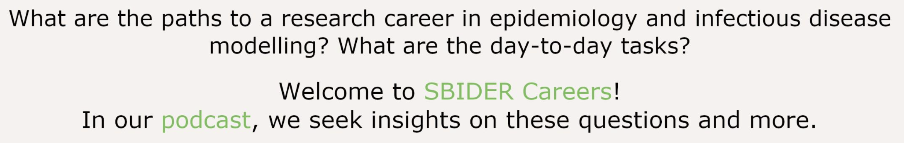
SBIDER Podcast Hub
Ed Hill @EdMHill KSMB-SMB 2024 31

